Slide 1


Sprint delivery
Sprint 1
Wednesday 11 mei, 2022

Slide 2
Content
Sprint 1
Sprint 2
Deliverables
What is next?
General
API
Dashboard
Smartwatch

Slide 3
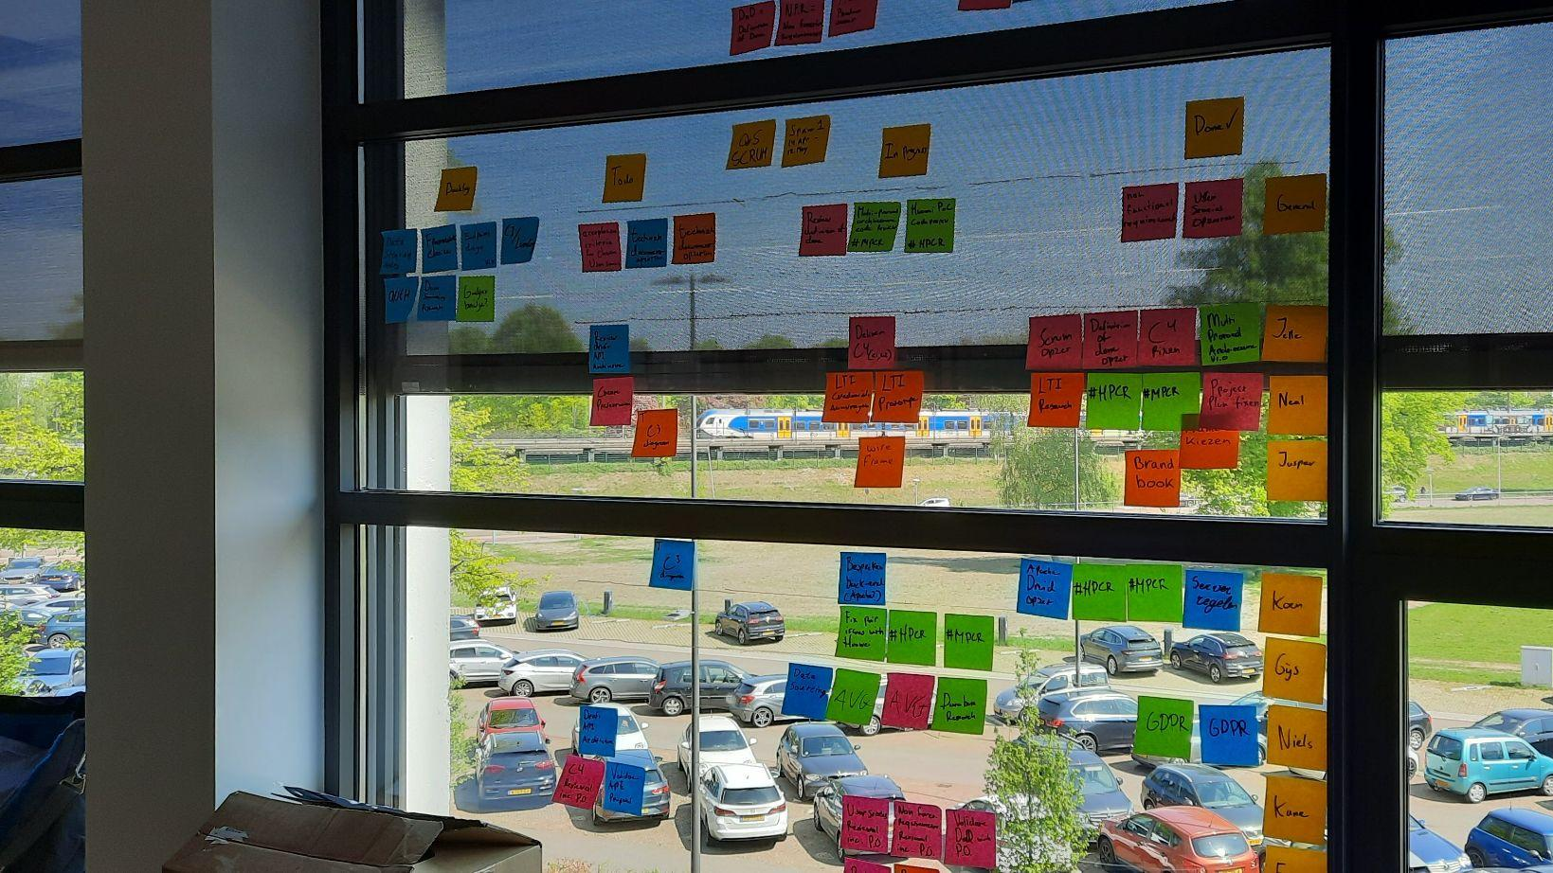
Sprint 1
“Defining what Quantified student is”
Notes:
The main mission for the first sprint

Slide 4
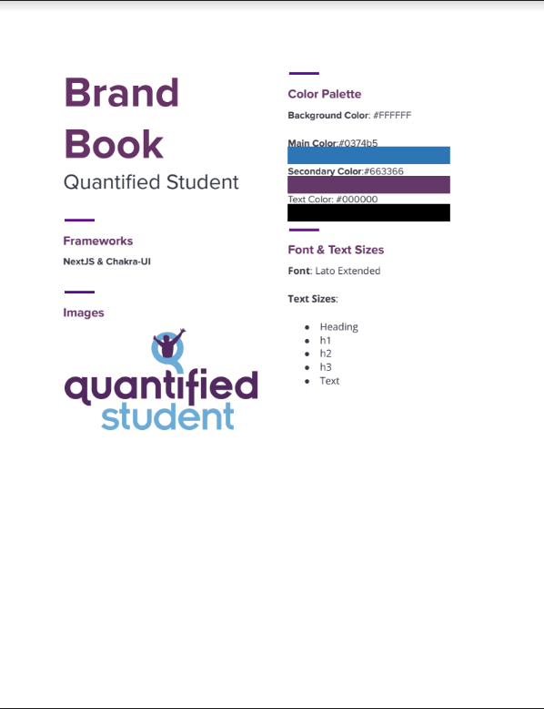


Deliverables - General
Project plan
Project analysis document
Brand book
Draft of context and container diagram
GDPR research
Notes:
Project plan
Outlining what the project is and the goal of the project
Analytic document
Defining the requirements of the project details with the help of user stories and acceptance criteria
Brand book
This documents defines what colors and text font will be used in marketing material and user interfaces for the project.
C4 articaticure diagram
The architecture for the project is very important. This document outlines how the all different services work together and how they are connected.
GDPR research
We process a lot of data, so it should be done privately and securely.

Slide 5

Deliverables - API
Data storage research
Draft of API component diagram

Slide 6
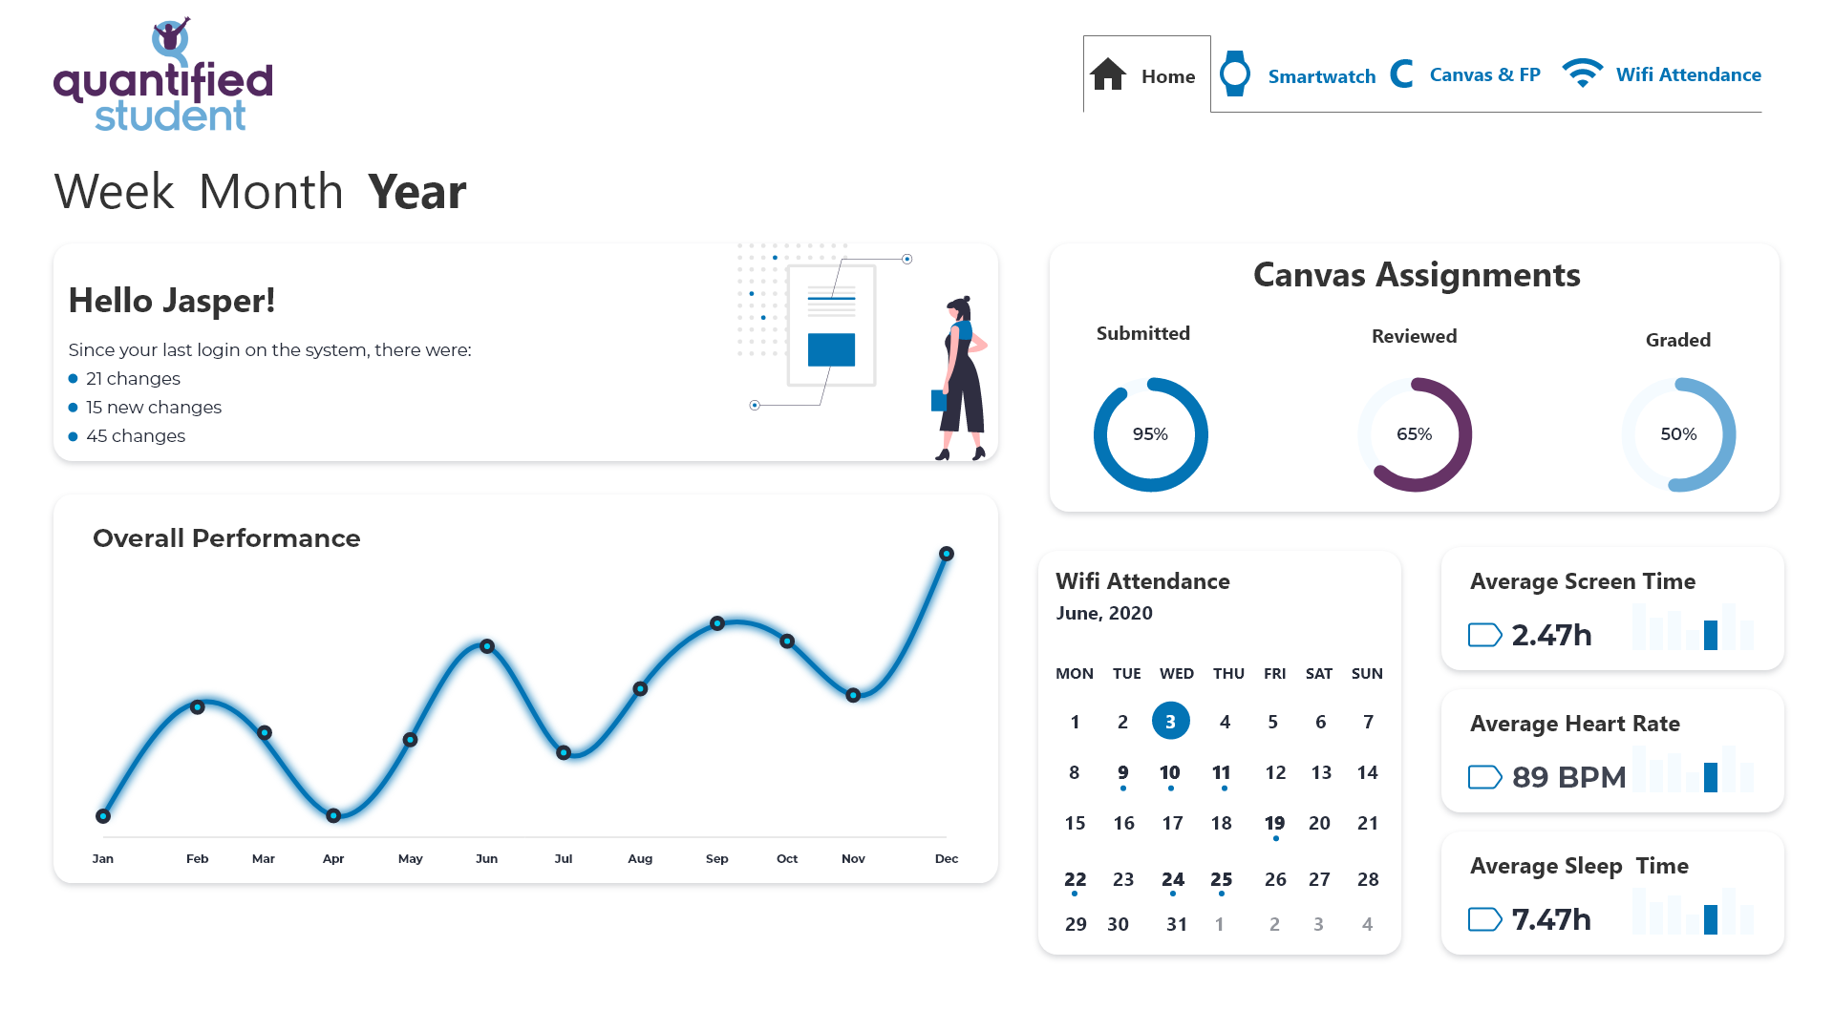
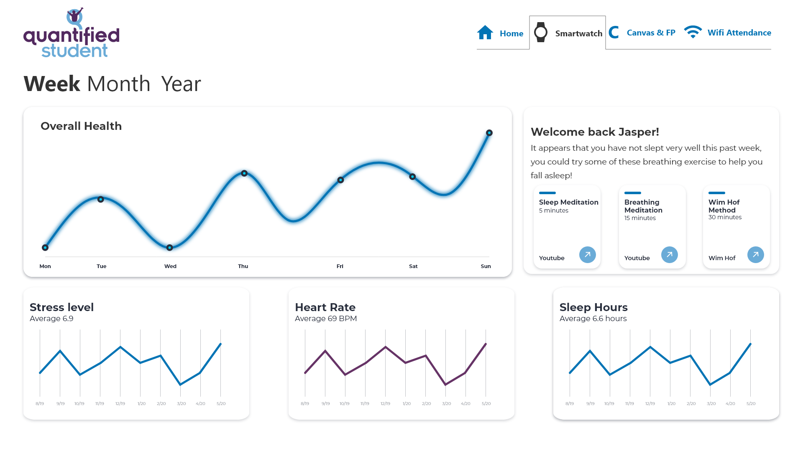
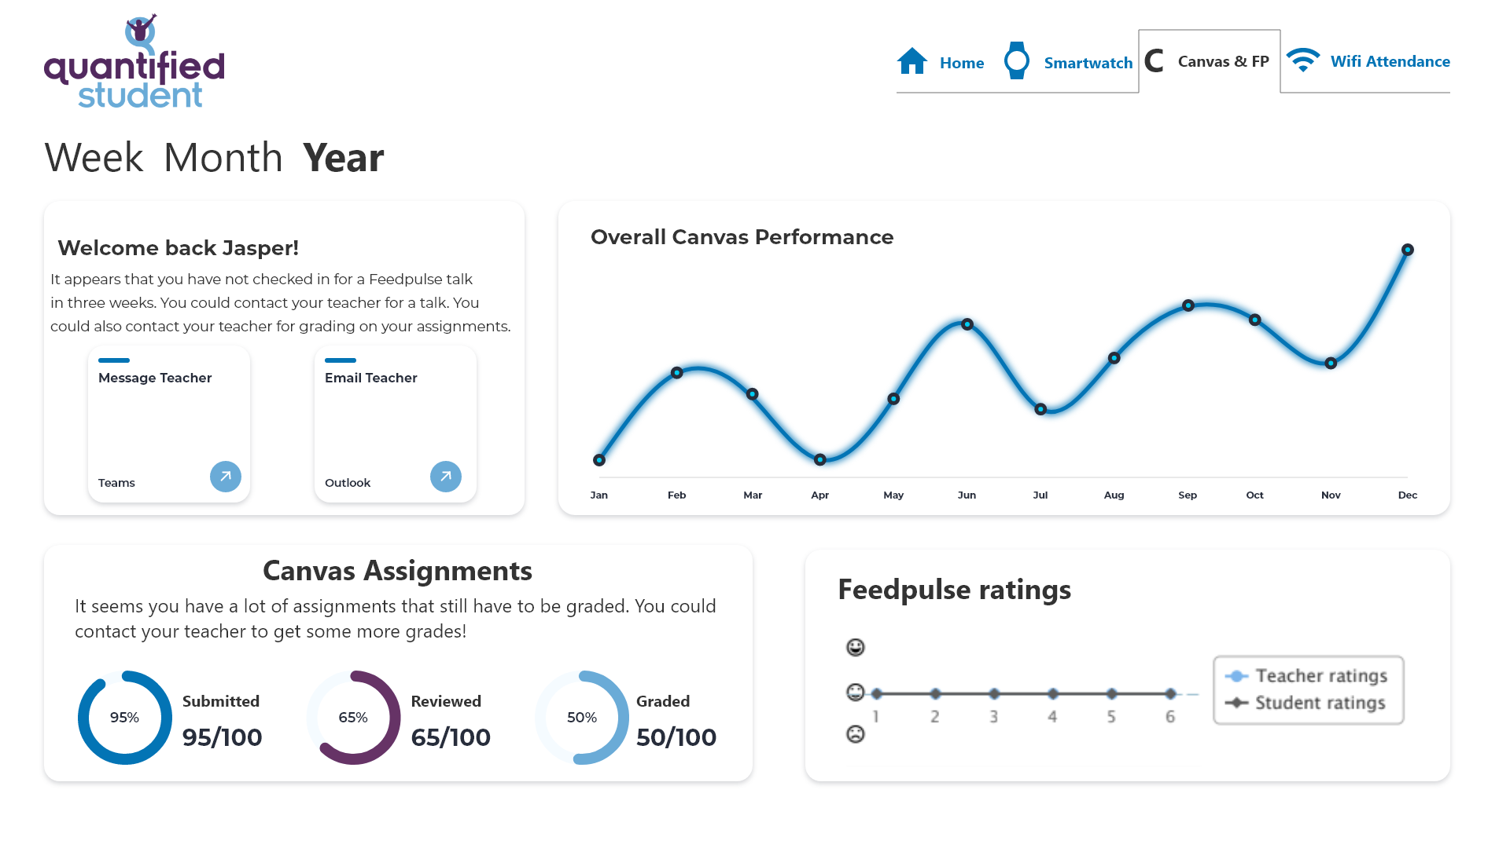
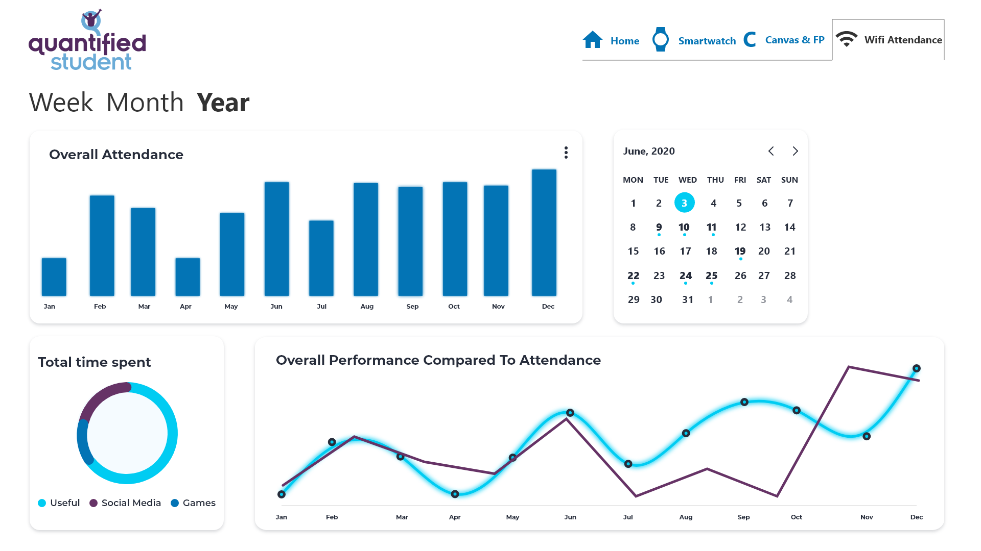
Deliverables - Dashboard
First draft of dashboard design

Slide 7
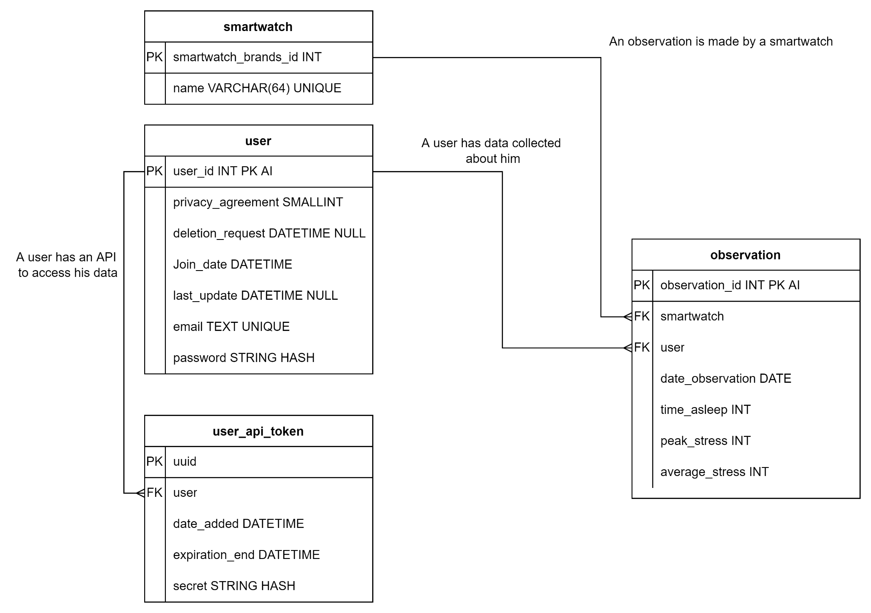
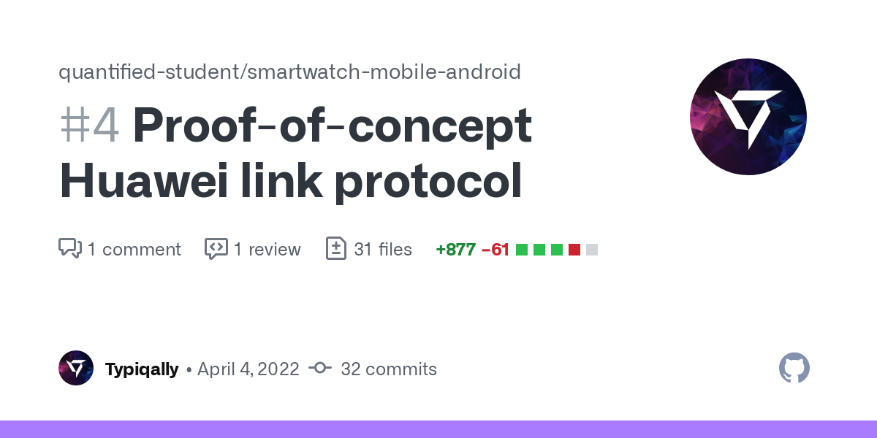
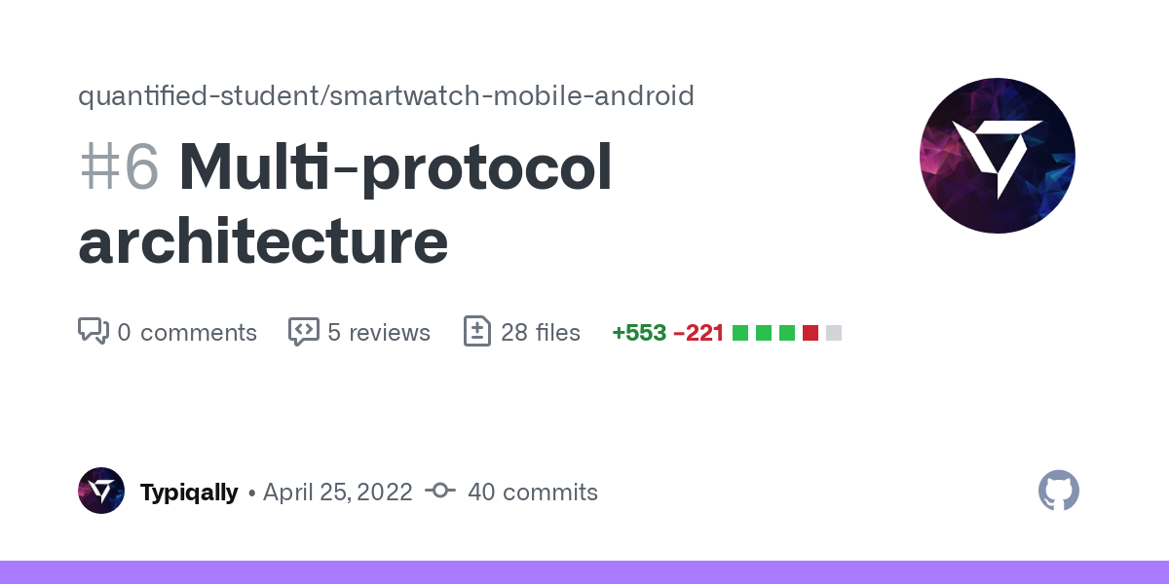
Deliverables - Smartwatch
Huawei Link protocol
Multi-protocol architecture
Database design
Notes:
Smartband
Protocol for the Huawei Band 6
Our first smartband has a working protocol added to the mobile app
Multi protocol architecture
Creating the support to add more protocols and smartwatches to the app.
ERD
A database scheme has been created to store and support the smartwatch project.

Slide 8
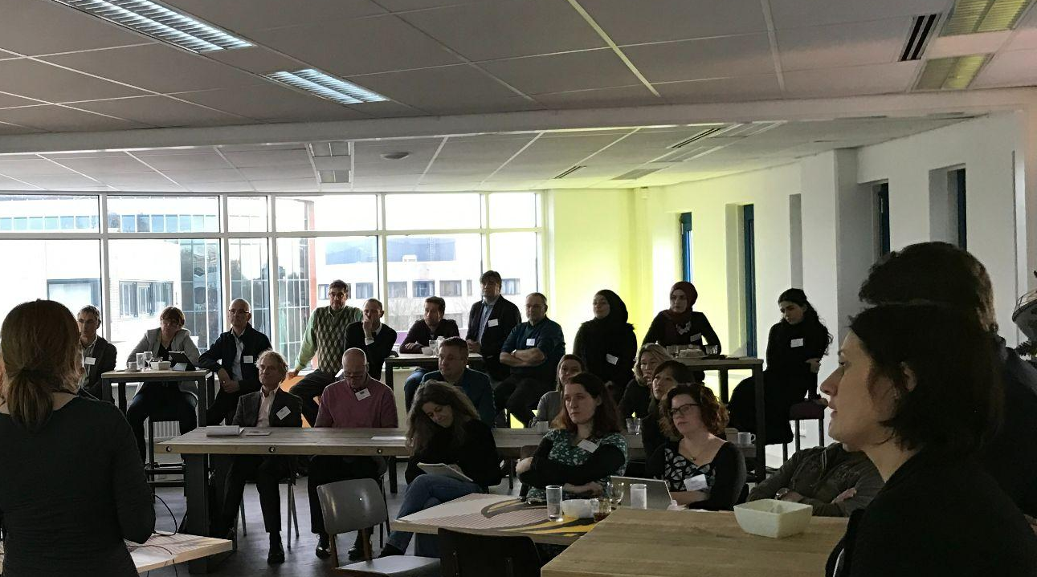
Next sprint.
Sprint 2

Slide 9
What is next?
What technologies are we going to use for the main API?
Other TO DO's
Are we using Apache Druid or a self made API or both?
Technical documents
LTI prototype
Setup API project
How will the data be displayed in the dashboard?
Creating a wireframe
Creating a prototype

Slide 10
End of sprint delivery
Any questions?
Wednesday 11 mei, 2022

